Slide 1
Face recognition at varying angles
USING MACHINE LEARNING
PRIYANKA V.
SANDHIYA S.
SOWMIYA S.
SREENITHI S.S.
SRIDEVI M.

Slide 2
WHAT IS FACIAL RECOGNITION?
It requires no physical interaction on behalf of user.
It is accurate and allows for high enrollment and verification rates.
It can use your existing hardware infrastructure, existing cameras ,image capturing devices work without any fault.
Access control includes offices, computers, phones, ATMs, etc. Most of these forms currently do not use face recognition as the standard form of granting entry, but with advancing technologies in computers along with more refined algorithms, facial recognition is gaining some traction in replacing passwords and fingerprint scanners

Slide 3
FACE DETECTION
The problem of face recognition is all about face detection.
Face Detection is used to find whether a face is find in input or not.
The algorithm used in this process is “Viola-Jones algorithm” , because the rate of accuracy in this algorithm is high and fast processing speed.
This algorithm can be summed up in four steps:
1) feature selection 3)feature learning to create a classifier
2)feature evaluation 4)cascading classifier

Slide 4
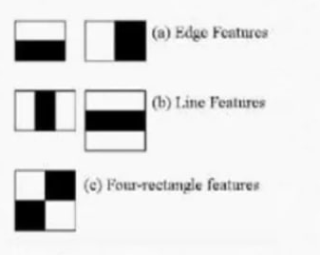
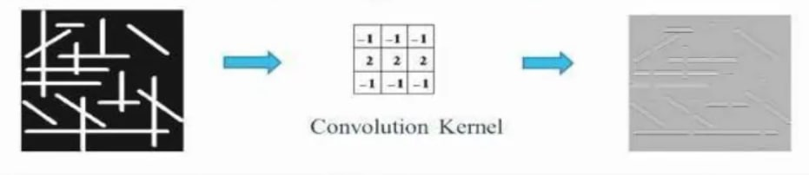
HAAR FEATURE(FEATURE SELECTION)
24 X 24 window as the base window size to start evaluating this features in any given images.
From this we can extract 1,60,000+ features from the image like nose,eyes,eyebrows etc.,

Slide 5

INTEGRAL IMAGE
In an integral image the value at pixel (x,y) is the sum of pixel to the left of (x,y)
Sum of all pixels inside a given rectangle uses only 4 values at the corner of a rectangle.

Slide 6

ADABOOST
This helps us to find best features among 1,60,000 + features.
Adaboost construct a strong classifier as a linear combination of these weak classifier.
F(x) = α1f1(x)+α2f2(x)+…

Slide 7

CASCADING
The basic principle of “Viola-Jones algorithm” is to scan the detector many times through the same image- each time with new size.
This algorithm will concentrate on discarding non faces quickly and spend more time on probable face regions.
Cascade classifier is used ,which is composed of stages each containing a strong classifier.

Slide 8
GIT LINK:
https://priyanka-vijaykumar.github.io/face-detection-mandhan/

